Slide 1
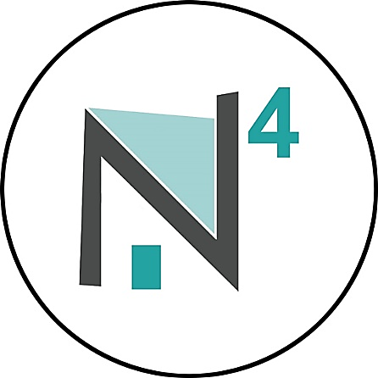
neighbor network of northern nevada (n⁴)
Presented by:
Amy Dewitt-Smith, MPA
Executive Director
Link · support · grow

Slide 2
Innovation in northern Nevada
New charitable 501(c)3 nonprofit organization located inside the Northern Nevada Center for Independent Living (NNCIL)
Programs designed to build social capital
Not only about leading people to more services, but leading people to more people!
Fully inclusive programs
Aim to have a membership that is representative of the people living in Northern Nevada
Core values blend the senior village movement with time banking

Slide 3
“village” defined
Membership-driven, grassroots organizations
Ran by volunteers and paid staff
Coordinate access to services including transportation, inspiring health and wellness programs, home repairs, and social activities
Wide range of village models; anywhere from I&R to elite concierge services
Networking culture of sharing resources – business development (Village to Village Network)
Over 200 villages are operating across the country, in Australia, and the Netherlands. 150 additional villages are currently in development.

Slide 4
Time banking
A time bank is a reciprocity-based work trading system in which hours are the currency. With time banking, a person with one skill set can bank and trade hours of work for equal hours of work in another skill set instead of paying or being paid for services.
Developed in 1980 by Edgar Cahn, an American professor of Law, to address unfulfilled societal needs in the wake of cuts to social programs during the Reagan administration. Cahn said he created the system as a way to reward “decency, caring and a passion for justice.”

Slide 5
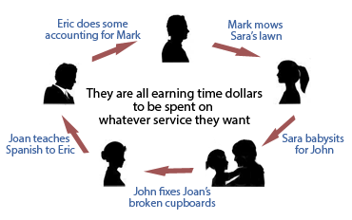

Slide 6
Asset-based community development (abcd)
Relationship building for a collective purpose - a path to organize people in a community in order to act together for the common good
Discover local community assets
“Practices & Principles” for mobilizing a community to move into action with residents at the center
Every community is a place filled with gifts to be given and care to be discovered.

Slide 7
N⁴ programs
Time Exchange
Volunteer Program
Information & Referral
Social & Recreational Opportunities
Coming January 2018… Community Care Program

Slide 8
Anyone can join!
Submit a join form at www.neighbornv.org
Application process includes references and criminal background check for all members; proof of vehicle insurance and registration for members providing transportation services
Orientation reviews core values of N4 and training on time exchange software
Mentors can be assigned, as needed
$60 application fee and $40 annual membership fee thereafter
Scholarships are available for people living in poverty, people with disabilities, and volunteers

Slide 9
Connect
Tell us about local services and resources
“Like” us on Facebook: www.facebook.com/NeighborNetworkNevada
Follow us on Twitter: #NeighborNV
Check-out our website: www.NeighborNV.org
Located at NNCIL: 999 Pyramid Way, Sparks
Call: (775) 453-4774
E-mail: people@neighbornv.org

Slide 10
Questions & Feedback
What approaches would you suggest to connect elders in our community?
What are the most requested services for elders?
What are the greatest gifts elders provide to others in our community?
What can N4 learn by connecting with elders, and how can we best go about this as an organization?
What is your favorite community resource?
Other questions or feedback?

